Slide 1
Details of Shelters in Buildings
100
101
102
103
104
105
106
107
108
109
201
202
203
204
205
206
207
208
209
211
212
213
214
215
216
217
301
302
303
304
305
306
307
401
402
403
404
405
406
407
408
409
410
411
501
502
503
504
505
506
507
508-9
604
605
802
901
902
905
906
1002
1004
1005
1102-5
1300
A + B
1401
1501
Exit
Exit the Shelters after 10 minutes

Slide 2
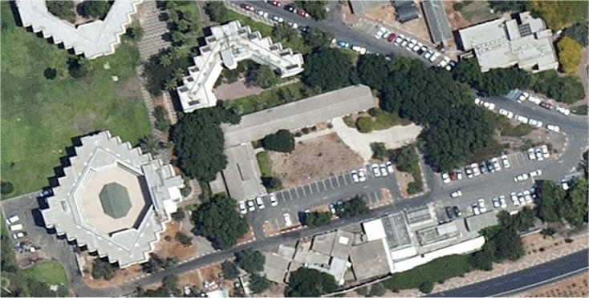
100
Animal research center
No Shelter at this location
Most protected space: 101 Sherman Shelter or 105 Exodus Shelter
Places: None
Highlights: None
Back >>

Slide 3
101
The Sherman dormitories
Shelter in the basement. 56 places
Most protected space: Shelter in Exodus 105 or Shelter in the 103 dormitories
Places: None
Highlights: None
Back >>

Slide 4
102
Rappaport labs
No Shelter at this location
Most protected space: Shelter in Exodus 105
Places: None
Highlights: None
Back >>

Slide 5
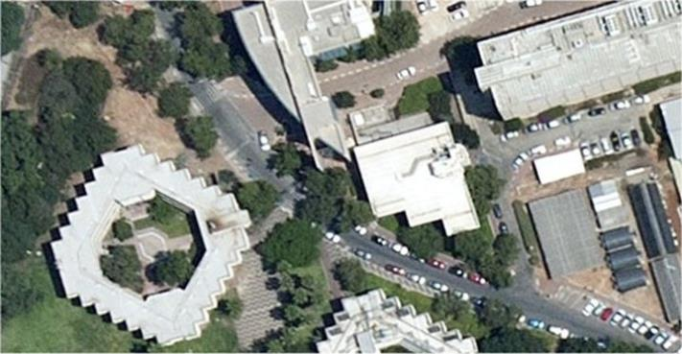
103
The Gaon dormitories
Shelter in the basement. 77 places
Most protected space: Shelter in Physic building 202 or basement level in Fraiman 201.
Places: None
Highlights: None
Back >>

Slide 6
104
The Wolfson dormitories
No Shelter in this location
Most protected space: Shelter in basement level in Fraiman 201 or shelter in Gaon dorms 103.
Places: None
Highlights: None
Back >>

Slide 7
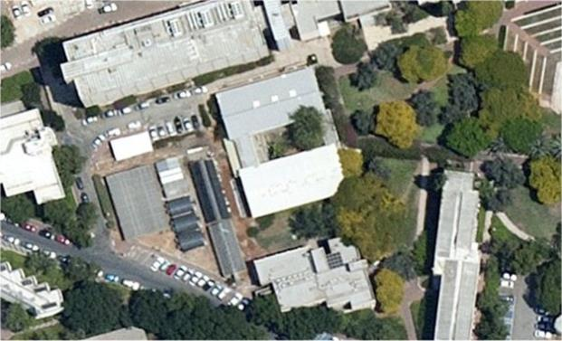
105
Exodus classrooms
Shelter in basement. 120 places
Most protected space: Shelter in Physics building 202 or basement level in Fraiman 201.
Places: None
Highlights: Opening the shelter by the Maintenance Dept.
Back >>

Slide 8
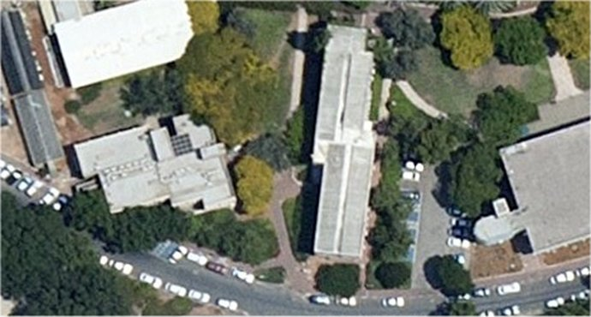
106
The Muskovitz dormitory
No Shelter at this location.
Most protected space: Shelter in the basement of Exodus 105.
Places: None
Highlights: Electra owns a storage room (in the east side) that can be used as a protective place.
Back >>

Slide 9
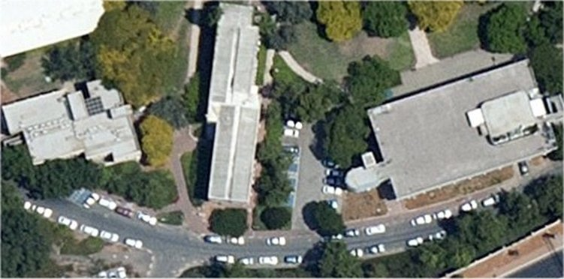
107
Student’s building
No Shelter at this location.
Most protected space: Shelter in the basement of Exodus 105
Places: None
Highlights: none.
Back >>

Slide 10
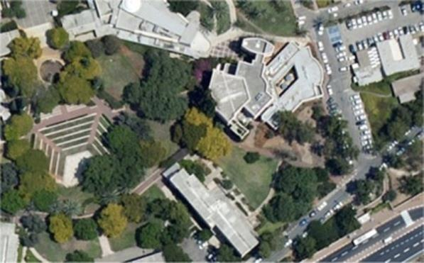
108
The Stollman dormetory
No Shelter at this location.
Most protected space: Storage room in Perach unit, or behind the Schleifer synagogue 304 or a small shelter in Feldman 301.
Places: 75 sqm.
Highlights: Opening the room behind the synagogue by David 054-4528683/ opening Perach storage room by Electra.
Back >>

Slide 11
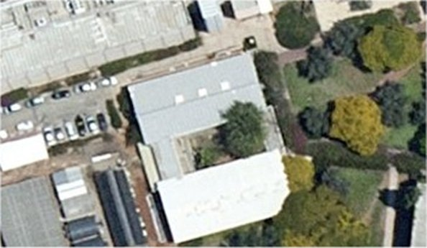
109
Lauterman building.
No Shelter at this location.
Most protected space: The south underground corridor or the shelter in Physics 202.
Places: 55 sqm.
Highlights: Coordinate the opening of the corridor with Prof. Kraus (Tel. 8762)
Back >>

Slide 12
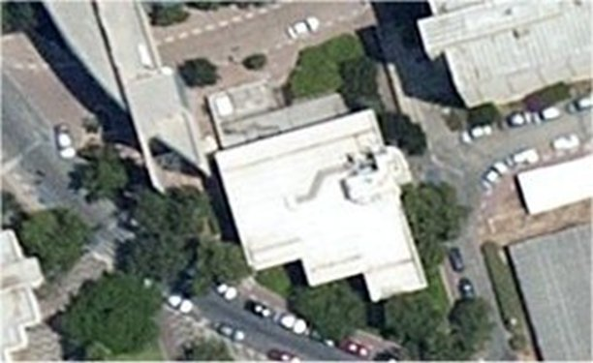
201
Fraiman Environmental Biology
Shelter in basement. 28 places.
Most protected space: The lower floor of the building.
Places: 294 sqm.
Highlights: Air filtered
Back >>

Slide 13
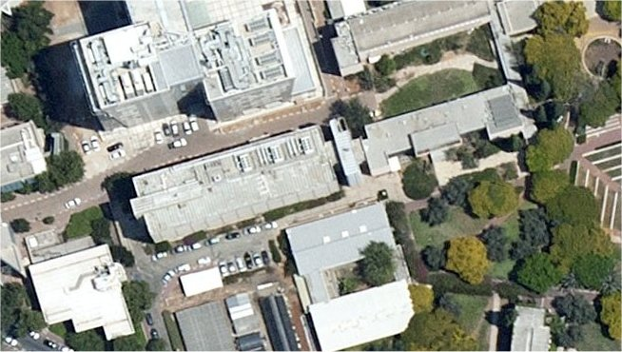
202
Physics research institute
Shelter in basement. 523 places.
Most protected space: Internal corridors at the 2nd-4th floor.
Places: 556 sqm.
Highlights: Coordinate the opening of the corridor with the Maintenance dept.
Back >>

Slide 14
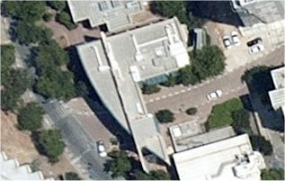
204
Gonda medical diagnostic center
Shelter in the basement. 50 places.
Most protected space: The 1st floor corridor
Places: 74 sqm.
Highlights: Coordinate the opening of the corridor with Prof. Kraus (Tel. 8762)
Back >>

Slide 15
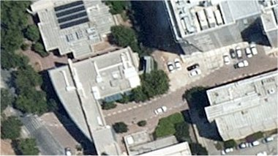
205
Lunenfeld life science center
No Shelter at the location.
Most protected space: Physics 202 basement shelter or the parking floors at Nanotechnology 206.
Places: None.
Highlights: None
Back >>

Slide 16
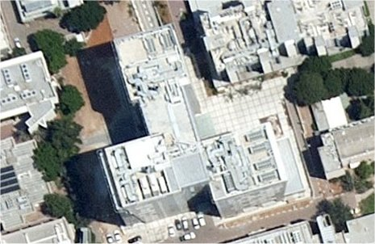
206
Nanotechnology triplex
Shelter in Mamads.312 places.
Most protected space: Underground parking zone.
Places: 5123 sqm.
Highlights: The Mamads are located in each floor in room B32. Some of them need to be unlocked by the building management office (Tel. 7067)
Back >>

Slide 17
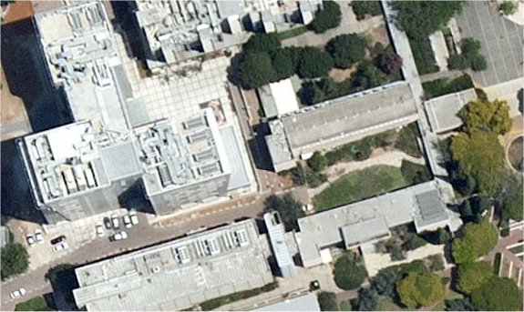
207
Carpel chemistry building
No Shelter at this location.
Most protected space: Lower floor corridor (near the toilet) far from the stairs, or shelters at Physics 202 or parking floor at Nano Technology 206.
Places: 11 sqm.
Highlights: None.
Back >>

Slide 18
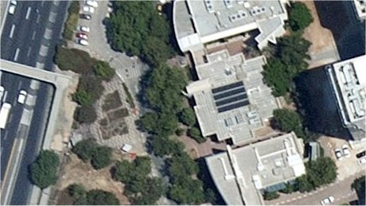
208
Cancer research center
Shelter in ground level. 51 places.
Most protected space: Staircase leading to the basement and the machine room in the basement floor.
Places: 58 sqm.
Highlights: There is a ramp for the disabled that needs to be placed outside the shelter to close the door.
שער גהה
Back >>

Slide 19
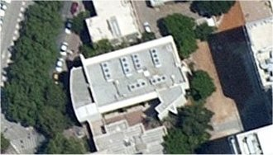
209
Resnick advanced technology
Shelter in Mamads. 63 places.
Most protected space: Lab in the basement.
Places: 302 sqm.
Highlights: The Mamads are located in rooms 015, 106, and 204. they need to be unlocked by the labs managers.
Back >>

Slide 20
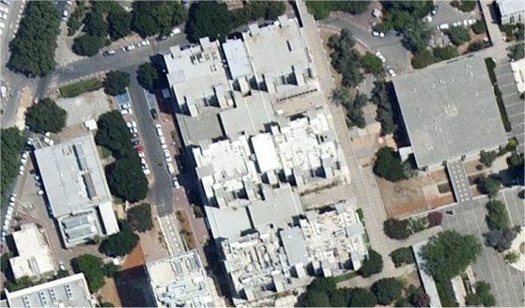
211
Lechter chemistry building
No Shelter at this location.
Most protected space: Dining room and eastern corridor on the ground floor, or the eastern corridors 1st-3rd floors, or in the library in Mexico 213.
Places: 199 sqm.
Highlights: None.
Back >>

Slide 21
212
Suissa life science building
No Shelter at this location.
Most protected space: eastern corridors on 1st-3rd floors, or in the library in Mexico 213.
Places: 185 sqm.
Highlights: None.
Back >>

Slide 22
213
Mexico social science building
Shelter in the basement. 9 places.
Most protected space: The library floor and also the west and east corridors on the 1st floor.
Places: 854 sqm.
Highlights: None.
Back >>

Slide 23
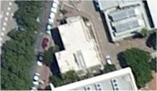
214
Schottenstein cellscan center
Shelter in the Mamads. 30 places.
Most protected space: Shelter in Finkler 208 or Mamads in Reznick 209.
Places: none
Highlights: The Mamads (Room 010, 120 & 230) are located in the south wing. The building is usually closed to the public and in time of emergency the front door should be coordinated to be opened.
Back >>

Slide 24
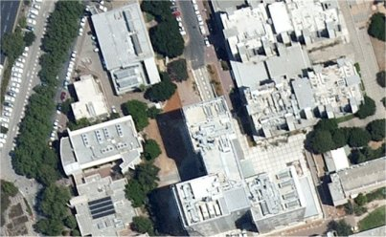
215
Energy center
No Shelter at this location.
Most protected space: Underground parking at Nano 206.
Places: none.
Highlights: None.
Back >>

Slide 25
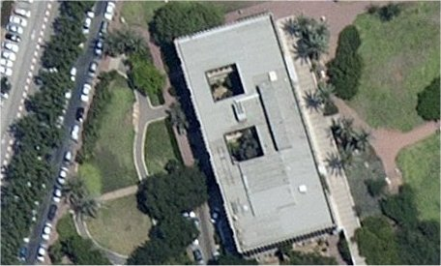
216
Mathematics & computer center
Shelter in the basement floor. 90 places.
Most protected space: The lower corridor in the southern building, or the parking floor at Nano 206.
Places: 66 sqm.
Highlights: Opening the shelter by the maintenance team.
03-5318381
Back >>

Slide 26
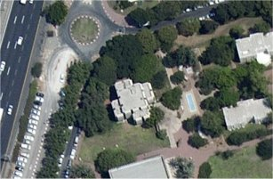
217
The Begin Building
No Shelter at this location.
Most protected space: Corridor near the elevator on the basement floor (as opposed to the door).
Places: 11 sqm.
Highlights: None.
Back >>

Slide 27
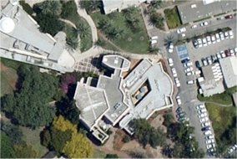
301
Feldman conference center
Shelter in Mamad, 19 places
Most protected space: Western corridor at the PR area.
Places: 50 sqm.
Highlights: Mamad in room 012. In the congress hall there is no shelter.
Back >>

Slide 28
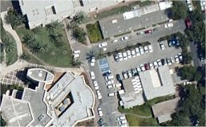
302
Logitics
No Shelter at this location.
Most protected space: East wing in the Logistics warehouse. Another option is a large room behind the synagogue.
Places: none
Highlights: None.
Back >>

Slide 29
303
Maintenance
No Shelter in this location.
Most protected space: East wing in the Logistics warehouse. Another option is a large room behind the synagogue.
Places: none
Highlights: None.
Back >>

Slide 30
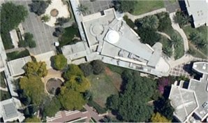
304
Pollack (Shlifer) lecture hall
No Shelter at this location.
Most protected space: The security dept. basement floor that continues to operate. Another option is a large room behind the synagogue.
Places: 123 sqm
Highlights: Opening the back room in the synagogue by David from the Campus Rabbi office.
Back >>

Slide 31
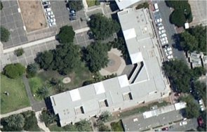
305
Lohn law & commerce building
Shelter in library basement level, 237 places
Most protected space: East wing in the Logistics warehouse and the maintenance inner corridor in the basement.
Places: 300 sqm
Highlights:. Opening the logistics warehouse or the maintenance corridor should be coordinated.
Back >>

Slide 32
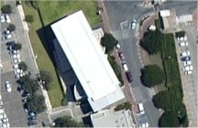
306
Benin real estate law wing
Shelter in Mamads, 33 places
Most protected space: Western staircase on the lower floors.
Places: 30 sqm
Highlights: Mamads are located in rooms 105 and 201. Opening those rooms should be coordinated.
Back >>

Slide 33
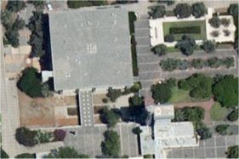
307
Wengrowsky “Lev Hacampus” observatory
No Shelter at this location.
Most protected space: Underground floors at Central library 401.
Places: none.
Highlights: None.
Back >>

Slide 34
401
Central library
No Shelter at this location.
Most protected space: Lower floors in the library and the ‘open shelf’ complex and the -2nd floor corridor.
Places: 871 sqm
Highlights: there is a 62 sqm shelter on the premises but it is not accessavle to the public.
Back >>

Slide 35
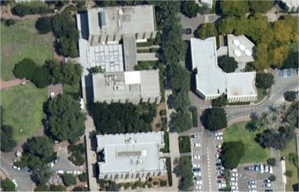
402
Stollman administration building
No Shelter at this location.
Most protected space: Cover at the lower floor: 063 auditorium and the corridor that leads to it.
Places: 117 sqm
Highlights: None.
Back >>

Slide 36
403
Grosberg education building
No Shelter at this location
Most protected space: 1st and ground floor corridors or ate shelter at Wolfson 404 basement.
Places: 93 sqm
Highlights: None.
Back >>

Slide 37
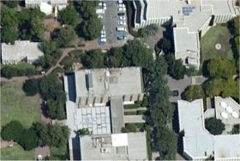
404
Wolfson hall of humanities
Shelter at the basement, 355 places
Most protected space: 1st and ground floor corridors at education building 403.
Places: none
Highlights: Coordinate opening the shelter via the maintenance or security depts.
Back >>

Slide 38
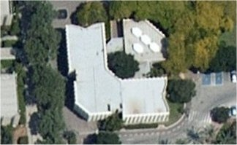
405
The Midrasha
Shelter at the Mamad, 25 places.
Most protected space: Shelter at basement of building 404, or the hallway at the archive compound.
Places: 29 sqm
Highlights: The Mamad is located to the northern area if the ground floor. Access to the archive compound only by the people working there.
Back >>

Slide 39
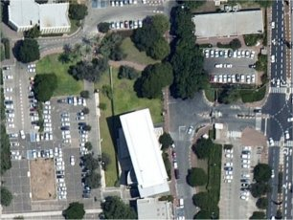
406
Mizrahi–Tefahot bank
No Shelter at this location.
Most protected space: Shelters at 305 or 306 buildings.
Places: none.
Highlights: none.
Back >>

Slide 40
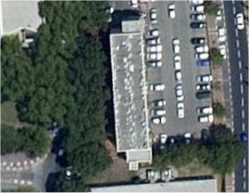
407
Rackman building (including Kukin, Finkle & Baker centers)
Shelter at the Mamads, 23 places.
Most protected space: None.
Places: none.
Highlights: The Mamads are located at rooms 110 and 210. opening them should be coordinated. Room 1S is too small and cannot be used in emergency.
Back >>

Slide 41
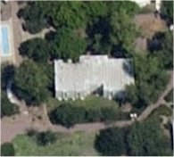
408
Krok school of education
No Shelter at this location.
Most protected space: The chairs display at the basement or the Shelter at 404 building basement.
Places: 33 sqm
Highlights: Opening the display should be coordinated.
Back >>

Slide 42
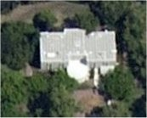
409
Krok faculty house
No Shelter at this location.
Most protected space: A cleaning storage room at the basement or the Shelter at 404 building basement.
Places: 15 sqm
Highlights: None.
Back >>

Slide 43
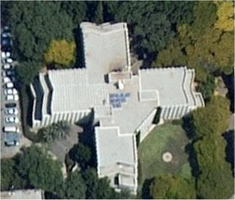
410
Rappaport Jewish studies
Shelter at the basement floor, 681 places.
Most protected space: The basement lobby and the corridors that leads to it and the Beck auditorium
Places: 141 sqm
Highlights: Opening the lab located in the shelter should be coordinated with the archeology dept.
Back >>

Slide 44
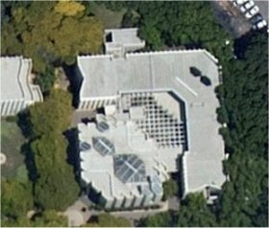
411
Institute of advanced Torah studies
No Shelter at this location.
Most protected space: Access to shelters at Jewish studies 410 through the external staircase to the basement.
Places: none
Highlights: Another way to 410 basement is through the Beck auditorium.
Back >>

Slide 45
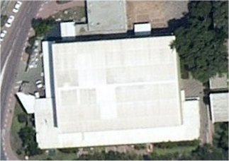
501
Sobell sports center
Shelter at the safety storage, 20 places.
Most protected space: Exit to shelters at Katz 604 or Stern 605.
Places: none
Highlights: opening the shelter should be coordinated with the safety dept.
Back >>

Slide 46
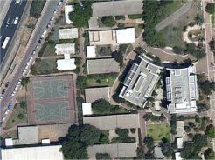
502
“Asbestonim”
No Shelter at this location
Most protected space: Head northeast to shelters at Katz 604 or Stern 605. Another option is the shelter inside class 25.
Places: none
Highlights: None
Back >>

Slide 47
503
The Grass computer science building
No Shelter at this location
Most protected space: Construction site
Places: none
Highlights: None
Back >>

Slide 48
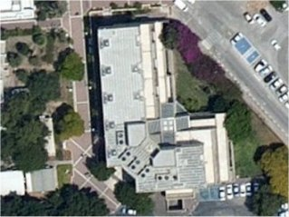
504
The Abraham center for economics
Shelter at the basement, 357 places.
Most protected space: The staircases and the corridors up to the 2nd floor.
Places: 505 sqm
Highlights: Opening shelter # 61 should be coordinated with HR office. Access to this shelter is also available through the ladies WC on the ground floor.
Back >>

Slide 49
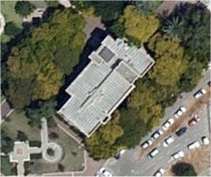
505
The Dahan Exodus classroom building
Shelter at the basement, 85 places.
Most protected space: Basement floor corridor.
Places: 55 sqm
Highlights: None
Back >>

Slide 50
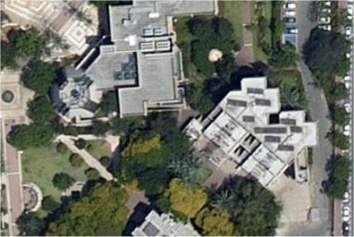
506
The Gruss Hubert dormitories
No Shelter at this location
Most protected space: Shelters at Dahan 505 and Negel 507 buildings. Alternatively, the underground shelter in the east wing of the building (which includes toilets and showers).
Places: around 200 sqm
Highlights: Electra has the keys to the gym complex. It is recommended to stay away from the mirrors installed on the walls of the complex.
Back >>

Slide 51
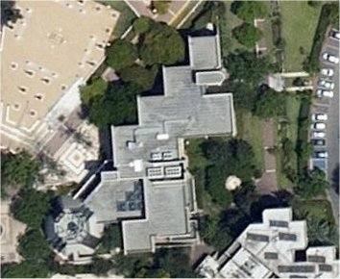
507
The Nagel Jewish heritage house
Shelter at the basement, 151 places
Most protected space: The basement floor and the technical space at the basement.
Places: 130 sqm
Highlights: None
Back >>

Slide 52
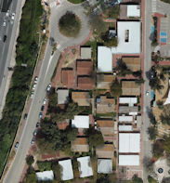
508-9
“Asbestonim”, Dean of students & Campus Rabbi
North shelter – 12
South shelter – 40 places
Most protected space: None
Places: None
Highlights: The hallway in from of the south shelter is not protected. The north shelter is located in the dean office. One can get to the Katz 604 or Stern 605 shelters.
Back >>

Slide 53
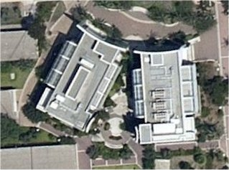
604
The Katz interdisciplinary studies building
Shelter at the Mamads, 157 places
Most protected space: The basement floor corridor.
Places: 108 sqm
Highlights: The Mamads are at room numbers 016, 064, 105, 205.
Back >>

Slide 54
605
The Stern graduate studies building
Shelter at the Mamads, 197 places
Most protected space: The basement floor corridor.
Places: 106 sqm
Highlights: The Mamads are at room numbers 016, 064, 105, 205, 307. Some of those Mamads need to be opened by the maintenance personals.
Back >>

Slide 55
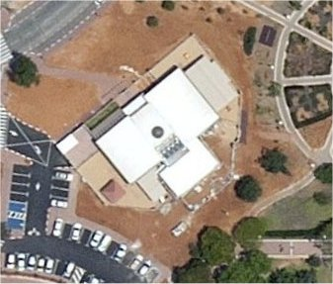
802
The Weisfeld day care center
Shelter at the Mamad, 36 places
Most protected space: It’s best not to try to reach nearby buildings as baby mobility might be slow
Places: none
Highlights: The Shelter maintenance is kept by the day care manager.
Back >>

Slide 56
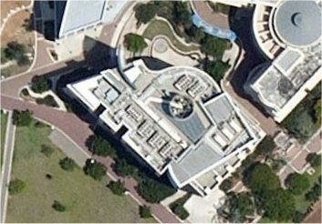
901
The Gonda (Goldschmied) brain research center
Shelter at the Mamads, 64 places
Most protected space: The auditorium at the basement floor.
Places: 268 sqm
Highlights: The Mamads are available only to those who are permitted to enter the building. The Mamads are at rooms 213 and 413. Opening those rooms must be coordinate with the labs managers
Back >>

Slide 57
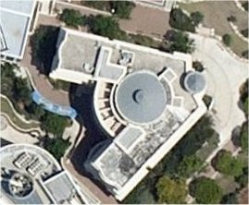
902
The Webb psychology building
Shelter at the Mamads, 75 places
Most protected space: There is a room near the secretarial section that can be used for protection and also the southern staircase
Places: 7 sqm
Highlights: The Mamads are at rooms 013, 108, 212, 324 and 420. Opening those rooms must be coordinate with the building technician.
Back >>

Slide 58
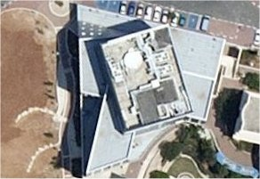
905
Jim Joseph education building
Shelter at the Mamads, 132 places
Most protected space: The auditoriums at the basement floor have external walls so they should not be used for protection. The east and west staircases are great for cover.
Places: 201 sqm
Highlights: The Mamads are at rooms 014, 120, 224, 324, 423 and 518. Opening those rooms should be coordinate with the faculty.
Back >>

Slide 59
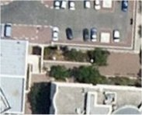
906
TATAK Energy center
No Shelter at this location.
Most protected space: The IPI office and the hallway are totally underground and has thick celling so it can serve as a shelter.
Places: 28 sqm
Highlights: Opening the IPI office in coordination with the company.
Back >>

Slide 60
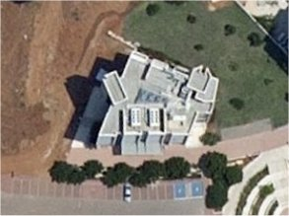
1002
Jakobovits–Shamoon centre
Study of philosophy, ethics & jewish thought
Shelter at the Mamads, 78 places
Most protected space: The staircases on the sides of the building are excellent and wide shelters.
Places: 259 sqm
Highlights: The Mamads are located at rooms 102 and 203. Opening Mamad 306 needs to be coordinated with the faculty.
Back >>

Slide 61
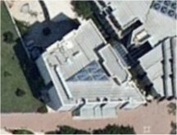
1004
The Kort language studies building
Shelter at the Mamads, 95 places
Most protected space: The staircases on the sides of the building are good for shelters. So is the kitchen at the basement floor.
Places: 189 sqm
Highlights: The Mamads are located at rooms 001, 101, 201,401 and need to be opened by the Faculty. Mamad 301 is usually open.
Back >>

Slide 62
1005
The Rosenberg music building
Shelter at the Mamads, 112 places
Most protected space: There is a staircase behind the stage that goes down to a dressing room which is wide and safe. There is also a shower and a WC there.
Places: 77 sqm
Highlights: The Mamads are located at rooms 018 and 110 that are usually open.
Back >>

Slide 63
110x
Engineering complex
Shelter at the Mamads, 298 places
Most protected space: The corridors leading from the lobby at the basement floor.
Places: 267 sqm
Highlights: The Mamads are located at (basement) 061, 071, 075, 081. (ground) 001, 021, 041, 051. (1st floor) 101, 121 and 141 (library), 161. (2nd floor) 201, 221, 241, 261. (3rd floor) 301, 321, 341 and 361.
Back >>

Slide 64
1501
The Dahan unity park
No Shelter at this location
Most protected space: The basement floor in the western side of the theater.
Places: 393 sqm
Highlights: The compound might be allocated for emergency purposes.
Back >>

Slide 65
1501
The Dahan unity park
No Shelter at this location
Most protected space: The basement floor in the western side of the theater.
Places: 393 sqm
Highlights: The compound might be allocated for emergency purposes.
Back >>

Slide 66
1401
The Wohl centre
No Shelter at this location
Most protected space: A staircase behind the eastern elevator leads to the underground and protected basement floor.
Places: more than 300 sqm
Highlights: None.
Back >>

Slide 67
1300
A + B
Park 100 – Student’s dormitories
No Shelter at this location
Most protected space: An underground tunnel that connects to two buildings is the best place to find cover. It can be reached via the staircases
Places: more than 1,200 sqm
Highlights:
Building A – Mamads in rooms X18 or X52 and clubs X18.
Building B – Mamads in rooms X04 or X32 and clubs X04.
The shelters are marked by these signs
Back >>

